Slide 1


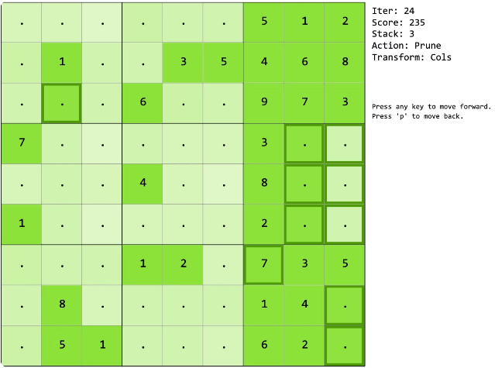


Sudoku Solver Visualizer
Welcome to the Sudoku Solver Visualizer! This presentation will introduce you to the fascinating world of Sudoku, its solving algorithms, and a visual exploration of the process.
by Govind Chourasiya

Slide 2

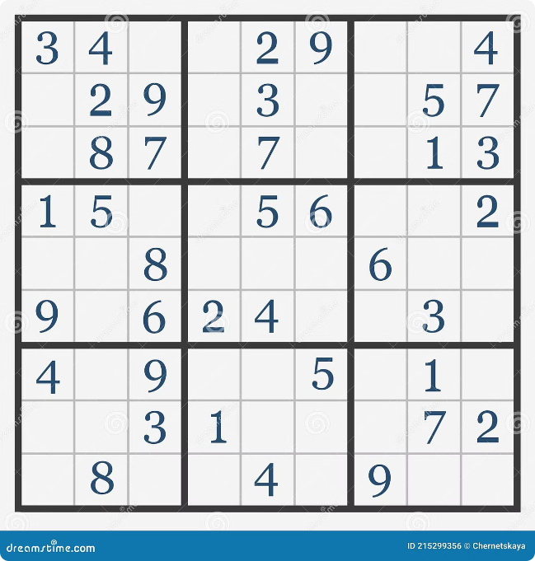
Overview of the Sudoku Puzzle
Objective
The goal of Sudoku is to fill a 9x9 grid with digits from 1 to 9, ensuring that each row, column, and 3x3 subgrid contains all the digits without repetition.
Rules
Sudoku follows a simple set of rules that make it both challenging and engaging.
Variations
While the standard Sudoku puzzle has 9x9 grids, there are variations with different grid sizes and difficulty levels.

Slide 3

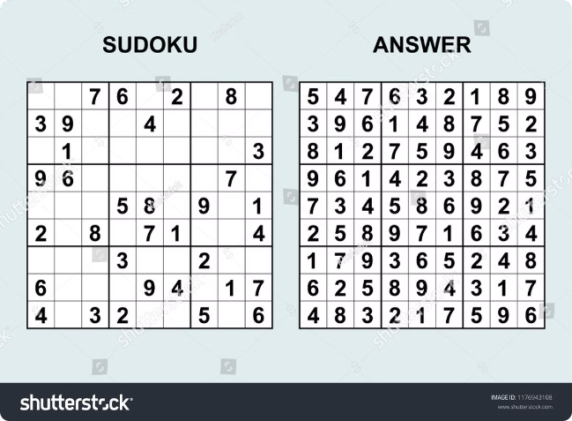
Solving Sudoku Puzzles
1
Manual Solving
Sudoku puzzles can be solved manually using logic and deduction, which can be a time-consuming and challenging process.
2
Computer Algorithms
Computer algorithms can solve Sudoku puzzles much faster and more efficiently, using techniques like backtracking.
3
Visualizing the Solution
The visualizer highlights the steps taken by the algorithm, making the process more transparent and understandable.

Slide 4


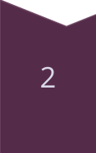
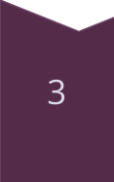
Backtracking Algorithm Explanation
Recursive Approach
The backtracking algorithm operates recursively, trying different possibilities for each empty cell.
Constraints
Each attempted number is checked against the Sudoku rules to ensure it is valid.
Backtracking
If a number leads to a conflict, the algorithm backtracks and tries a different value.

Slide 5
Implementing the Backtracking Algorithm in Java
Data Structures
Recursion
Validation
A two-dimensional array is used to represent the Sudoku grid.
The recursive function explores possible solutions for each empty cell.
The code checks for conflicts in rows, columns, and subgrids.

Slide 6
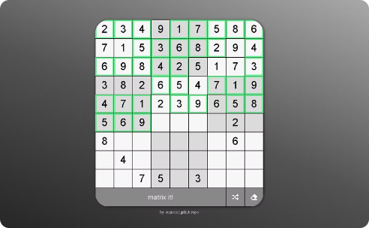
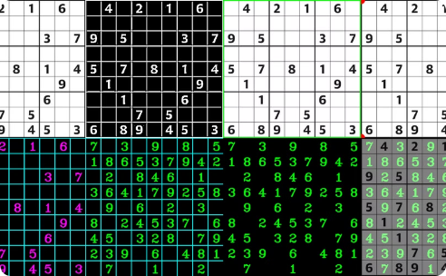
Visualizing the Solving Process
Cell Highlighting
Number Updates
Conflict Detection
Each cell that is being considered by the algorithm is highlighted.
The algorithm's attempts are visualized by changing the numbers in the cells.
Invalid moves are highlighted with a specific color or error message.

Slide 7
User Interface and Interactivity
1
Input Grid
2
Start/Pause Button
3
Speed Control
The user can input their own Sudoku puzzle.
Allows the user to control the visualization process.
The user can adjust the speed of the visualization.
4
Solution Display
The solved Sudoku grid is displayed once the algorithm finds a solution.

Slide 8

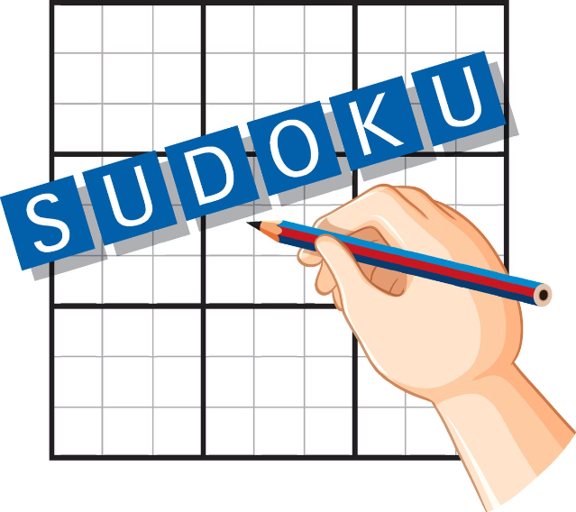
Conclusion and Future Enhancements
The Sudoku Solver Visualizer offers a valuable learning tool for understanding the backtracking algorithm. Future enhancements could include advanced algorithms, different Sudoku variations, and more interactive features.

